Slide 1

Vel Tech Rangarajan Dr. Sagunthala R&D Institute of Science and Technology
School of Computing
Department of Computer Science and Engineering
10211CS224 / FULL STACK APPLICATION DEVELOPMENT (JAVA)
PROJECT REVIEW : MILESTONE PROJECT – 2
Date: 20-04-2026
EVENT TICKET BOOKING SYSTEM
SDG: SDG No – SDG 9 – Industry, Innovation and Infrastructure
Presented By:
M.LOKESH– VTU25638 – 23UECS0328
Courses Handling Faculty:
Dr- Hafizur Rahman
ASSISTANT PROFESSOR

Slide 2
INTRODUCTION
✅ Use this for Event Ticket System:
Traditional ticket booking systems lack seamless experience and instant confirmation
Users face difficulty in managing bookings and accessing tickets
No proper downloadable ticket system in many basic platforms
The proposed system is a web-based Event Booking System
Users can browse, book, and manage event tickets easily
System generates PDF tickets instantly after booking
Improves user experience, reliability, and accessibility

Slide 3
PROBLEM STATEMENT
Existing systems do not provide smooth booking flow
Users cannot easily download or manage tickets
Lack of real-time availability updates
Poor UI/UX leads to confusion
No centralized system for users, organizers, and admins
Need for a scalable and user-friendly ticket system

Slide 4
OBJECTIVE(S)
To develop a web-based event booking system
To provide easy ticket booking and management
To implement PDF ticket generation system
To ensure secure payment and fast performance

Slide 5
PROPOSED SYSTEM
Users can browse and search events
Book tickets with real-time availability
System generates PDF ticket instantly
Organizers manage events and pricing
Admin monitors system activity
Works on both mobile and desktop
Improves efficiency and user satisfaction

Slide 6
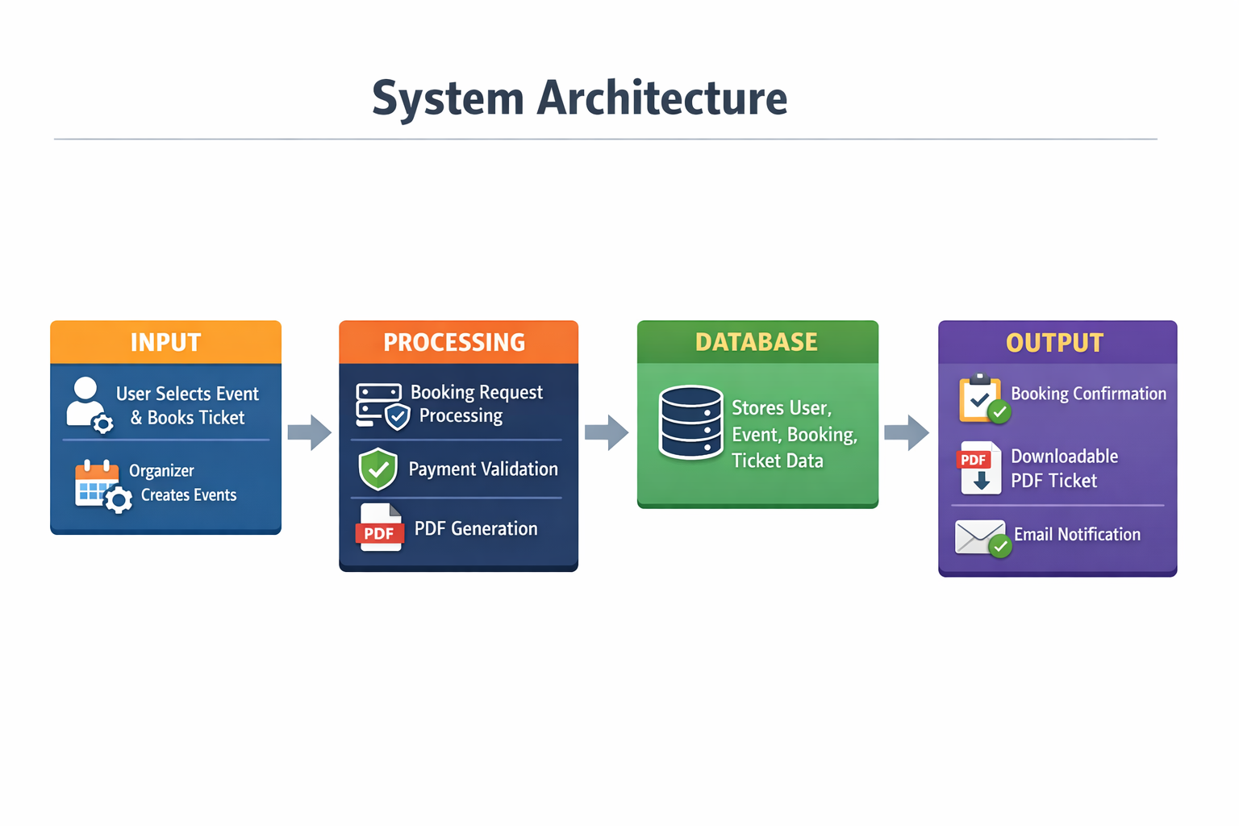
PROPOSED SYSTEM ARCHITECTURE
Input:
User selects event and books ticket
Organizer creates events
Processing:
Backend processes booking request
Payment validation
PDF generation
Database:
Stores user, event, booking, ticket data
Output:
Booking confirmation
Downloadable PDF ticket
Email notification

Slide 7
PROPOSED SYSTEM ARCHITECTURE
Input:
User selects event and books ticket
Organizer creates events
Processing:
Backend processes booking request
Payment validation
PDF generation
Database:
Stores user, event, booking, ticket data
Output:
Booking confirmation
Downloadable PDF ticket
Email notification

Slide 8
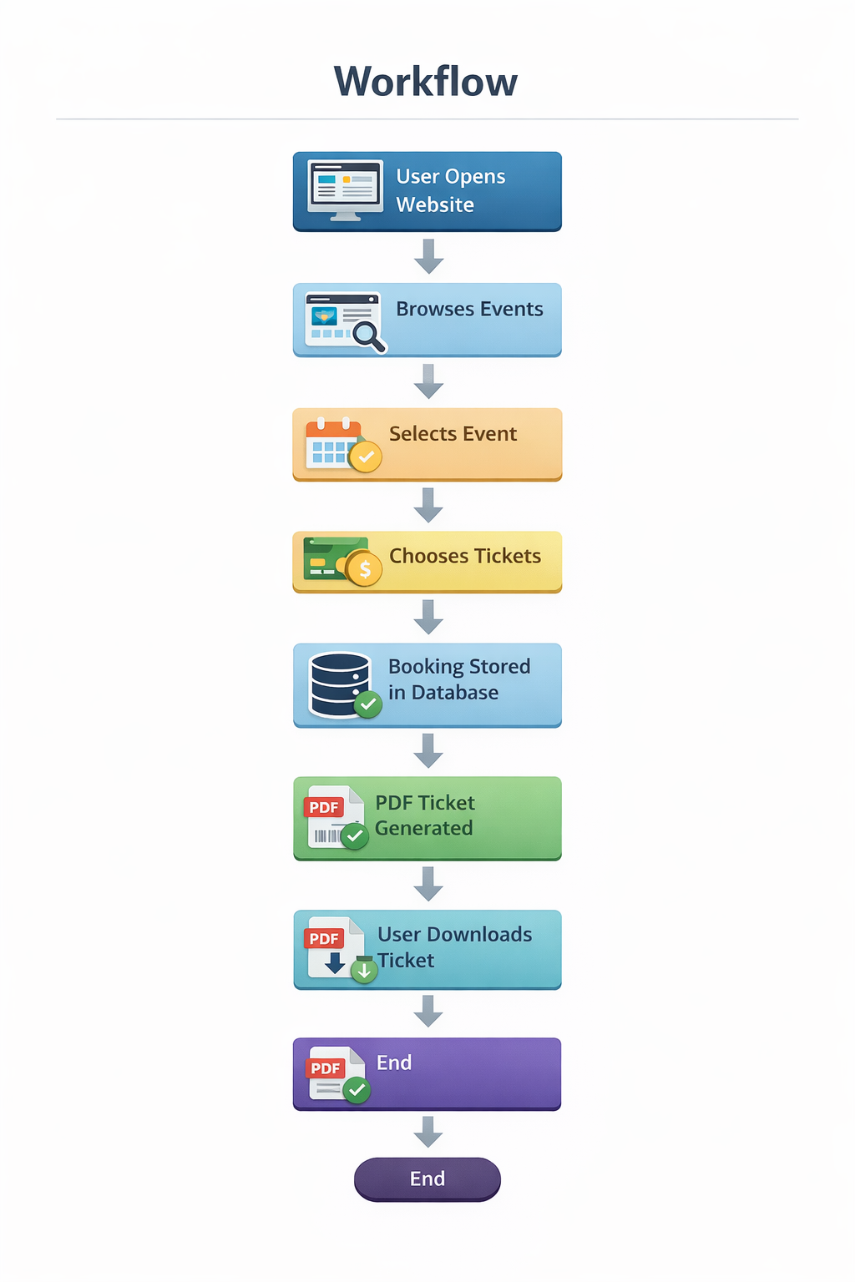
WORKFLOW

Slide 9
TECHNOLOGIES USED
Frontend:
React / HTML / CSS / JavaScript
Backend:
Node.js / Express
Database:
MongoDB / PostgreSQL
Tools:
VS Code
Git
PDF Generation:
Puppeteer / PDFKit

Slide 10
MODULE DESCRIPTION
Module 1: Event Management
Create, edit, delete events
Module 2: Booking System
Users book tickets
Module 3: PDF Ticket Generation
Generates downloadable ticket
Module 4: User Management
Profile, bookings, history
Module 5: Admin Dashboard
Monitor users and bookings

Slide 11
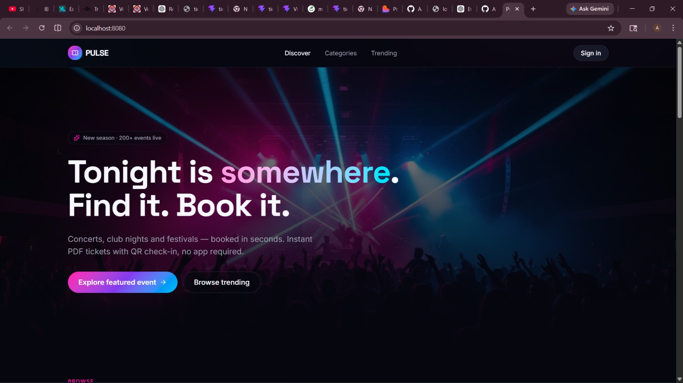
IMPLEMENTATION SCREENSHOTS

Slide 12
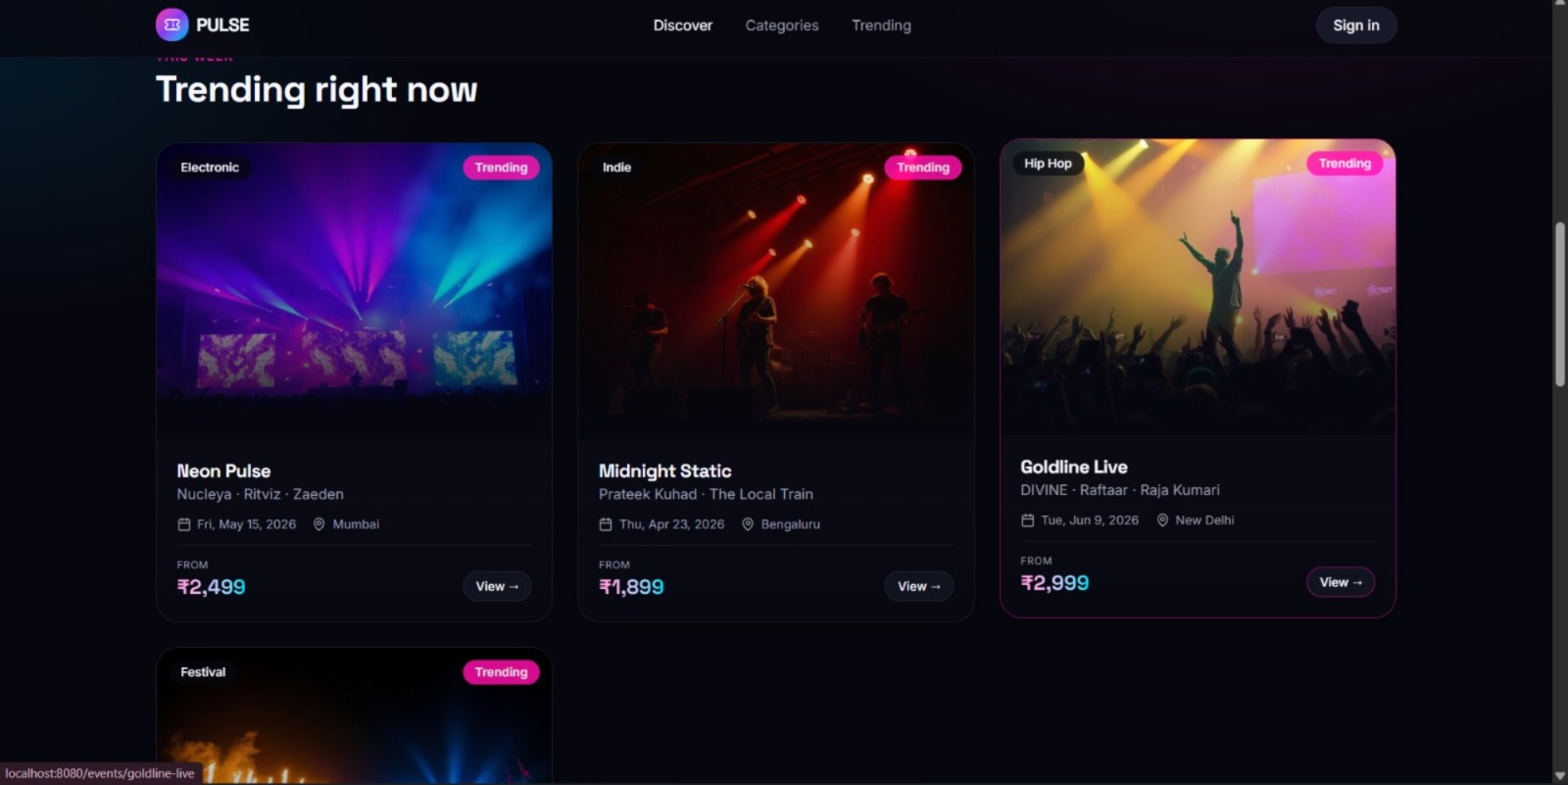
IMPLEMENTATION SCREENSHOTS

Slide 13
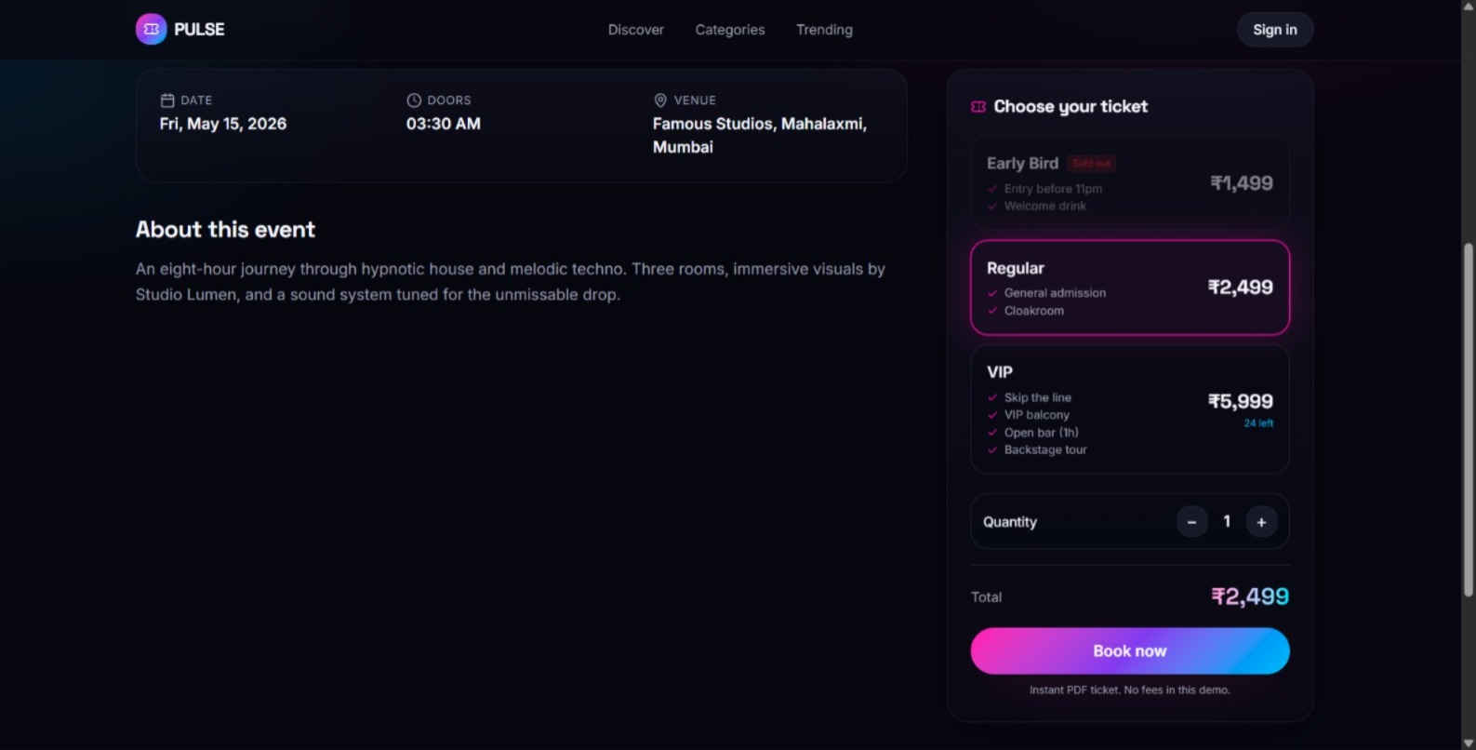
IMPLEMENTATION SCREENSHOTS

Slide 14
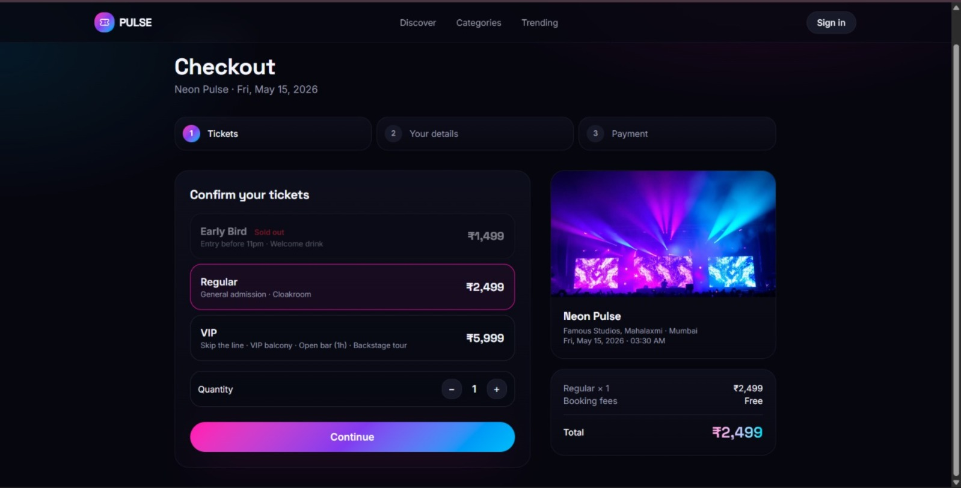
IMPLEMENTATION SCREENSHOTS

Slide 15
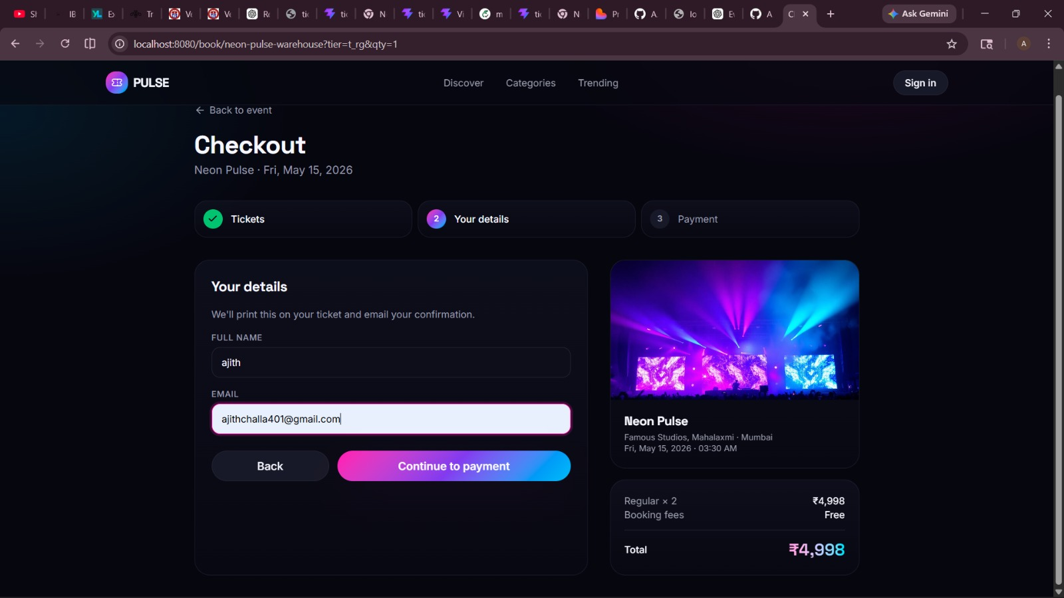
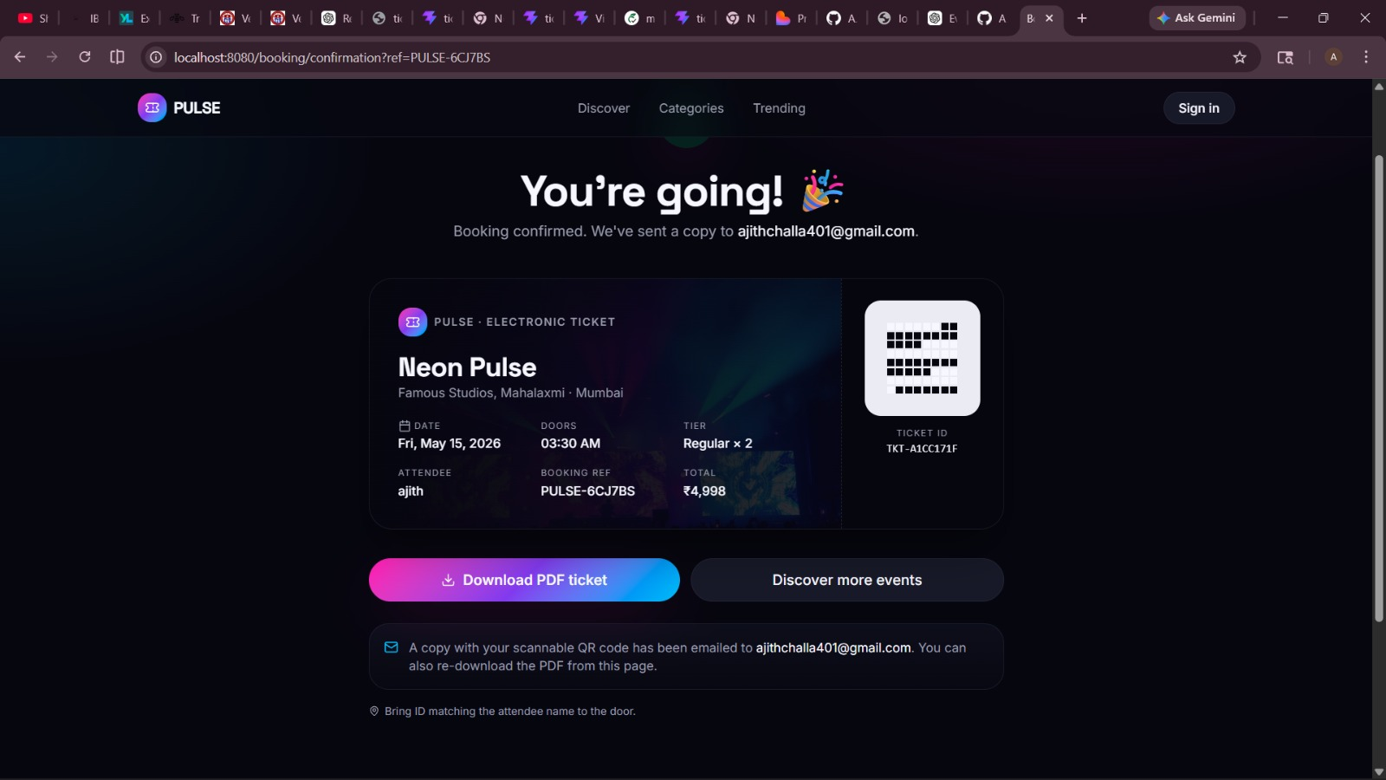
IMPLEMENTATION SCREENSHOTS

Slide 16
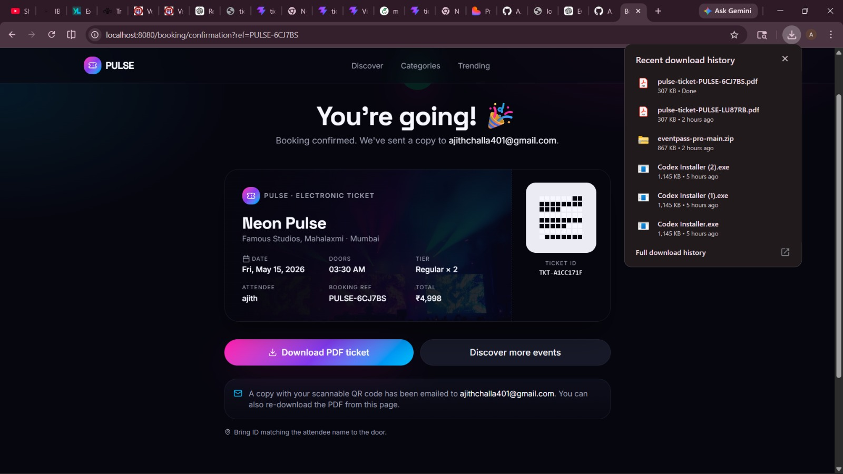
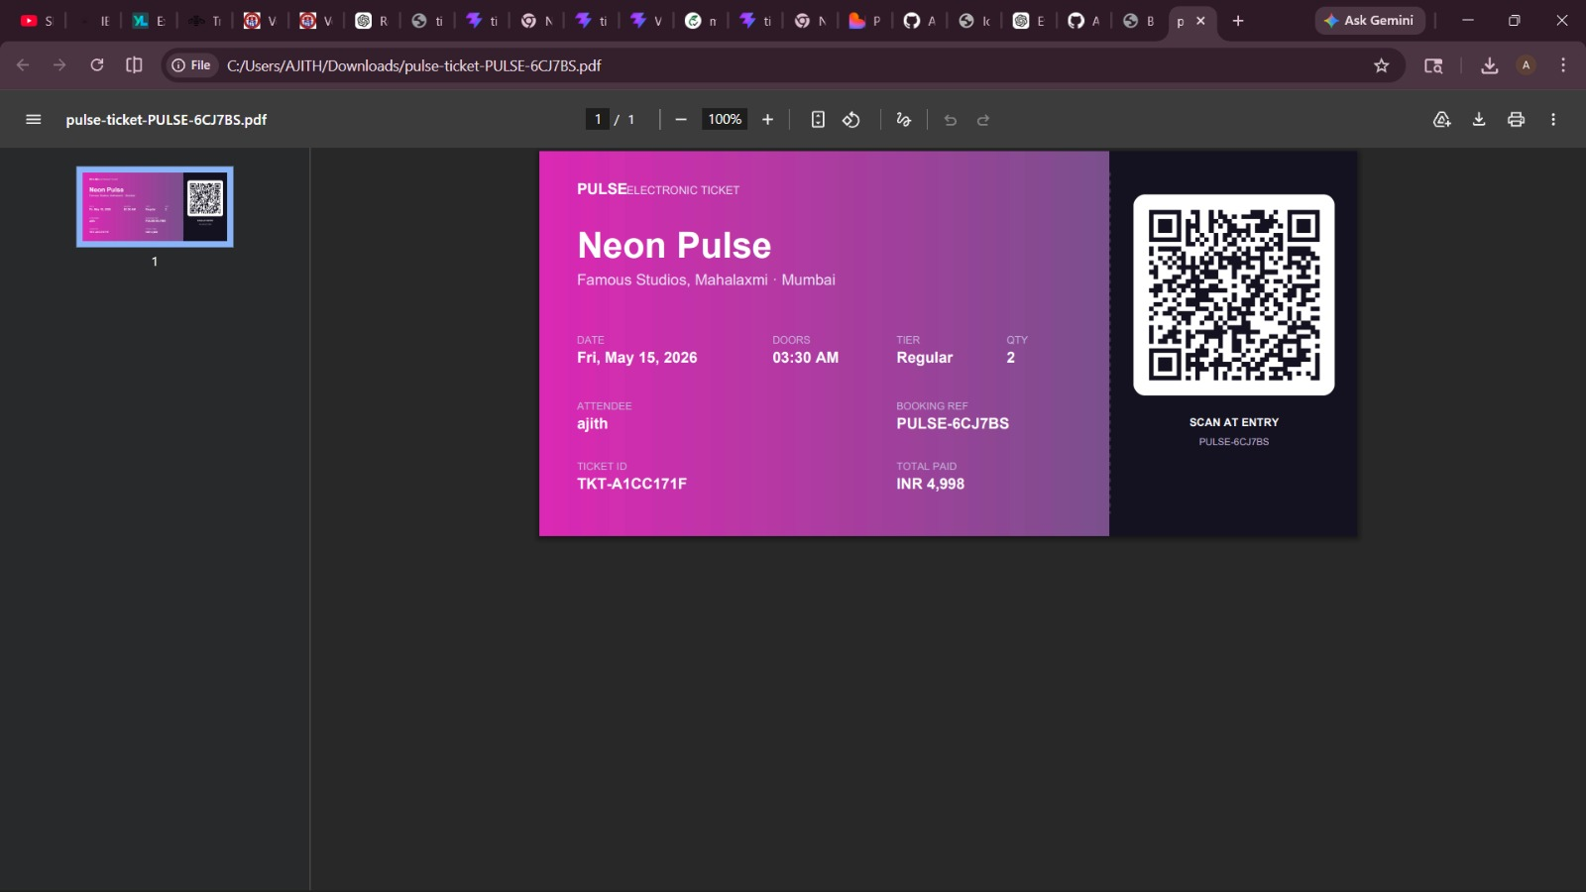
IMPLEMENTATION SCREENSHOTS

Slide 17
ADVANTAGES & LIMITATIONS
✅ Advantages:
Easy ticket booking
Instant PDF download
Secure payment
User-friendly UI
Multi-device support
❌ Limitations:
Requires internet
Payment gateway dependency
High traffic may affect performance

Slide 18
Thank you

